Slide 1

Heart Disease Analysis and Predictions
Sandra botica
Ufuoma atakere

Slide 2

Overview
Objectives
Process
A breakdown of the dataset
Visualizations and analysis
Machine learning

Slide 3
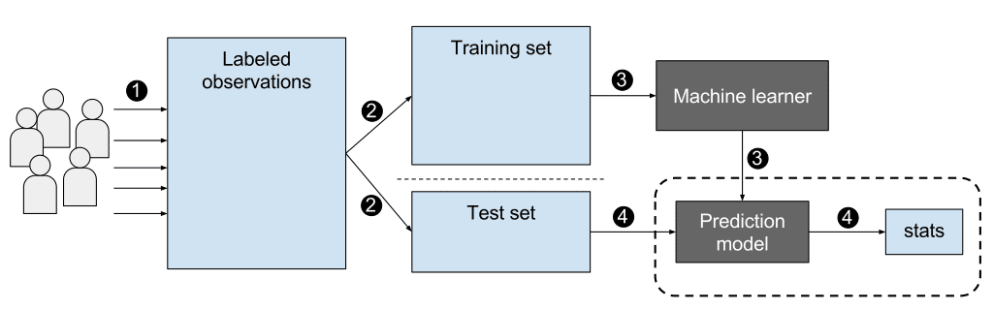
The purpose of this analysis was to use our knowledge of supervised machine learning to create a binary classifier that can predict the chance of heart disease.
Notes:
https://blogs.nvidia.com/blog/2018/08/02/supervised-unsupervised-learning/

Slide 4
Get data
Read in csv
Clean and Prepare data
No NULL
Train Model
Logistic Regression
Test Data
Optimize Data
Train-Test-Split
Save predictions
Features
Random Forest
Make decision on whether to drop any features
Train-Test-Split
Fit model
Evaluate Model
Accuracy score
Confusion Matrix
Classification report
Feature Selection
Hyperparameters
Neural network
Summary statistics
Value-counts
Histograms
Bar/pie plots
Pair plot
Correlation matrix
Principal Component Analysis
Scaling Data
Notes:
Data was gotten from Kaggle

Slide 5
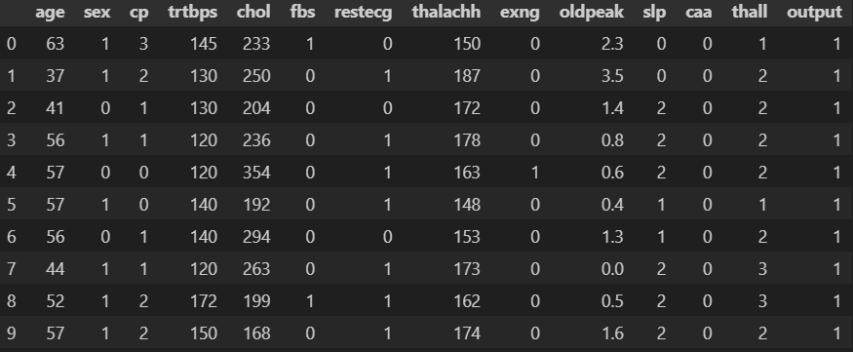
Dataset https://www.kaggle.com/datasets/rashikrahmanpritom/heart-attack-analysis-prediction-dataset?select=heart.csv
Notes:
Cleaned and prepared removed all null values

Slide 6
About the DATASET
age : age of the Patient
sex: Sex of the Patient
ca: Number of Major Vessels (0-3)
cp: Chest Pain Type
1. typical angina
2. atypical angina
3. non-anginal pain
4. asymptomatic
trtbps: resting blood pressure(mmHg)
chol: cholesterol(mg/dl)
fbs: fasting blood sugar (>120mg/dl)(1=true,0=false)
restecg: resting electrocardiographic results:
0. normal
1. have abnormality
2.probable abnormality
thalach: maximum heart rate achieved
Output: Diagnosis
0-less chance of heart disease
1- more chance of heart disease
exng: exercise induced angina (1 = yes, 0 = no)
oldpeak: - old peak: ST depression induced by exercise relative to rest
slp: the slope of the peak exercise ST segment (0 = unsloping, 1 = flat, 2 = downsloping)

Slide 7







Data Exploration

Slide 8
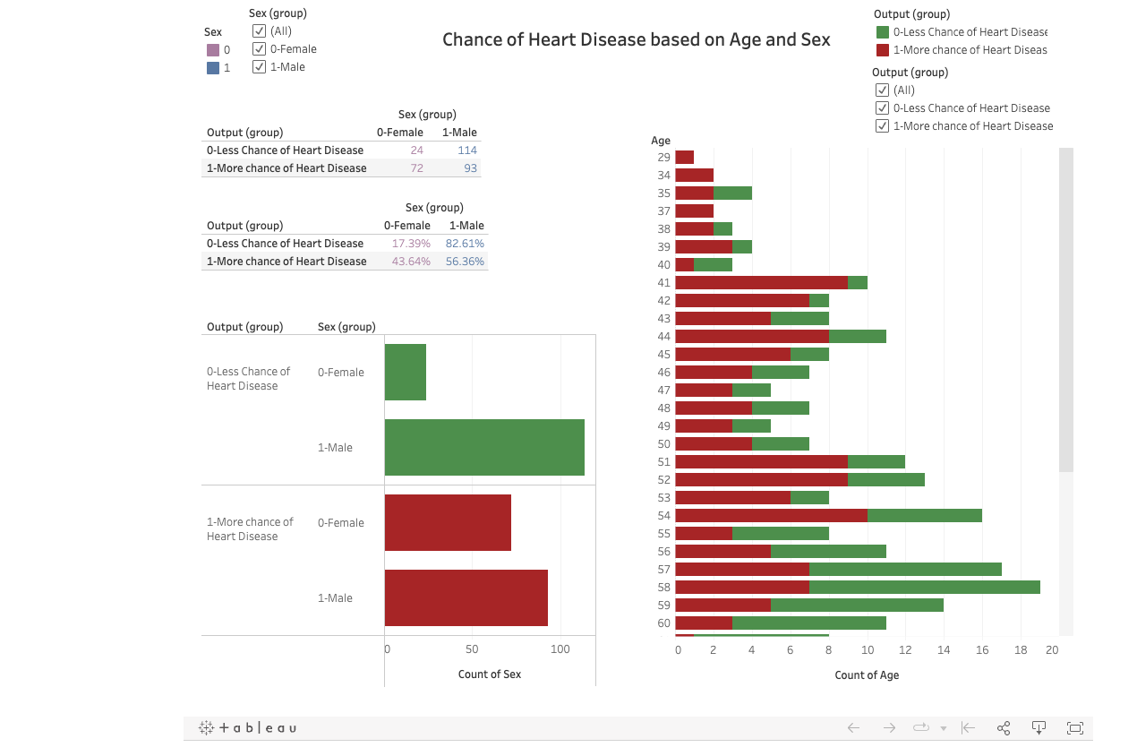
Dashboard for each feature filtered on chance of heart disease

Slide 9
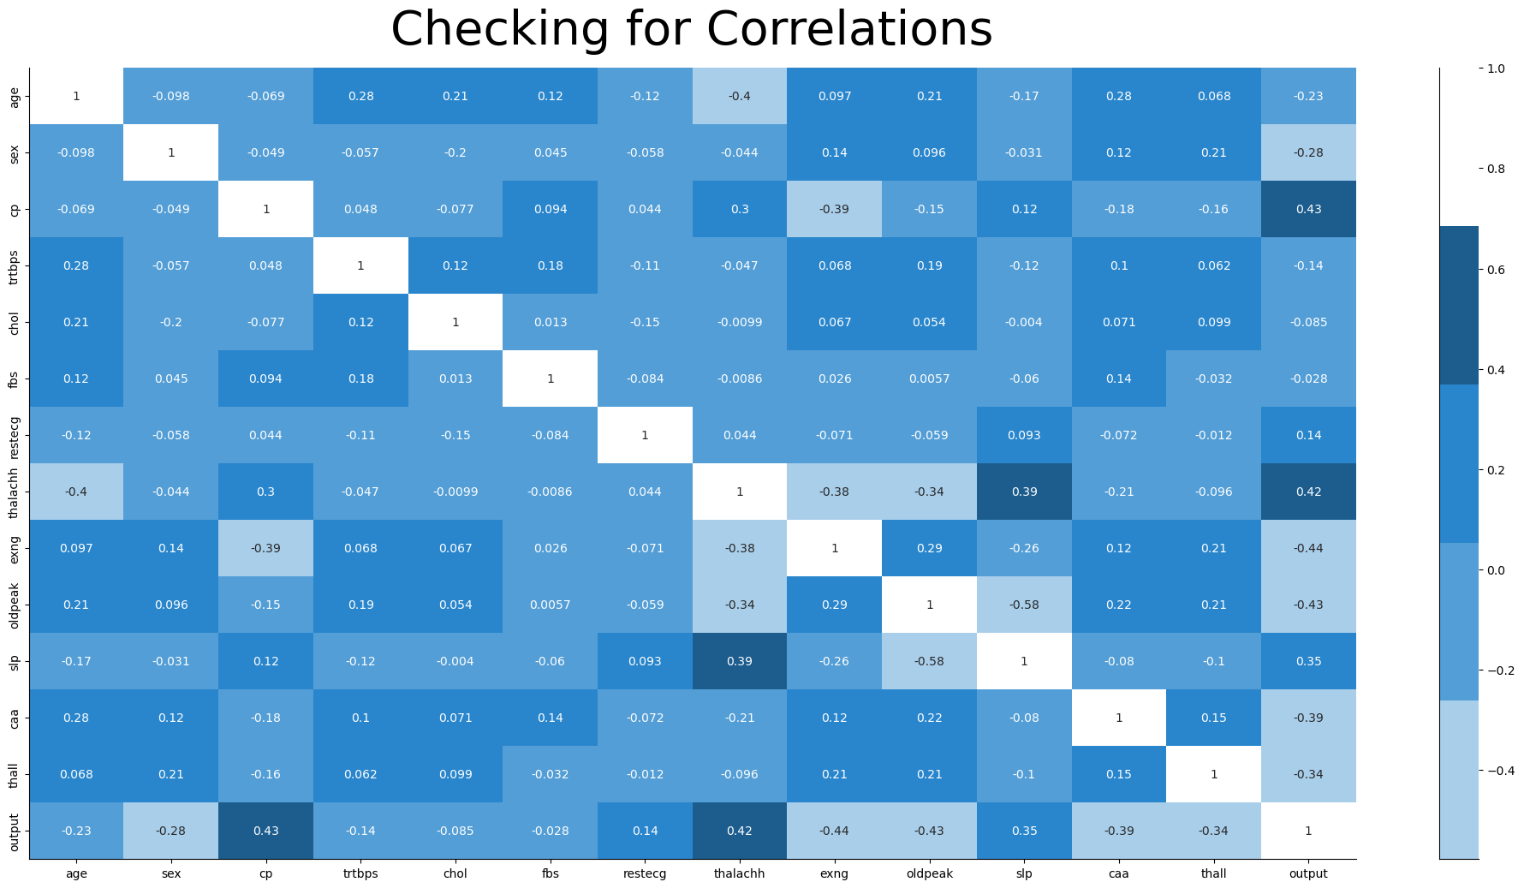
Notes:
Correlation was done to determine which features to drop for better accuracy

Slide 10
ML Models & Data Optimization
Random Forest Feature Selection
Logistic Regression Train-Test-Split
Neural Network Hyperparameters

Slide 11
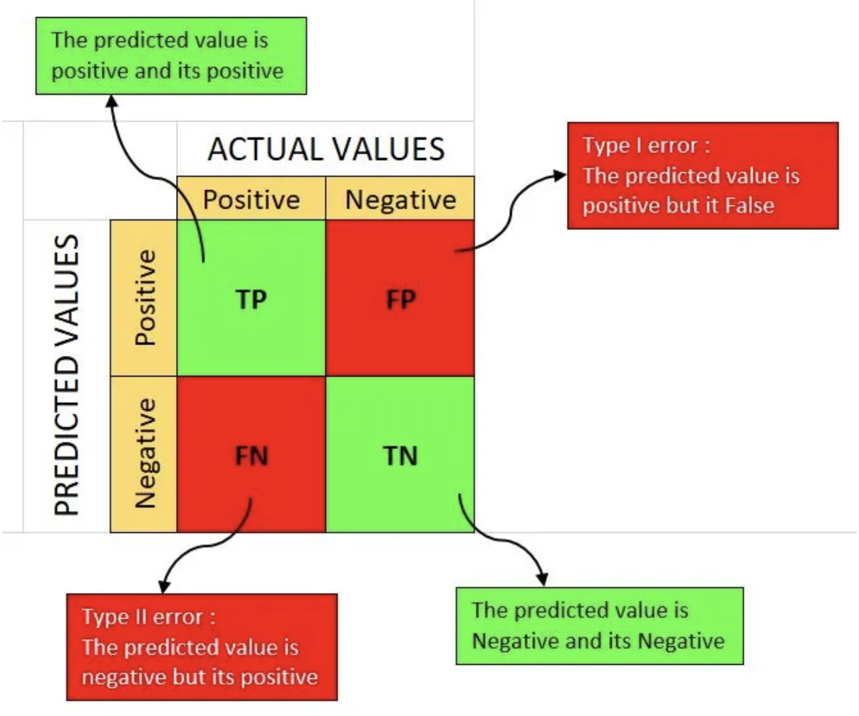
Confusion Matrix Classification Report Accuracy Score
Notes:
https://medium.com/analytics-vidhya/what-is-a-confusion-matrix-d1c0f8feda5

Slide 12

Conclusion & Questions
Notes:
https://scienceline.org/2019/12/new-ai-can-screen-for-heart-disease-risk/

